Slide 1
Creating the new PERK Inventory
real-world lessons using Asp.net, mvc, and entity framework

Slide 2
The tutorial
“Getting Started with Entity Framework 6 Code First using MVC 5“
https://docs.microsoft.com/en-us/aspnet/mvc/overview/getting-started/getting-started-with-ef-using-mvc/creating-an-entity-framework-data-model-for-an-asp-net-mvc-application

Slide 3
The Repo
\\pol-hquserver\GitRepos\PERK.git

Slide 4
Lesson 1- initial models, views, controller, and database
commit 10ad4bfc8902b403e19083c6e5633f9662aeb4a2
Author: dobkid01 <dobkid01@montgomerycounty.gov>
Date: Thu Jan 18 10:39:05 2018 -0500
Added Case controller. Generated first database.

Slide 5
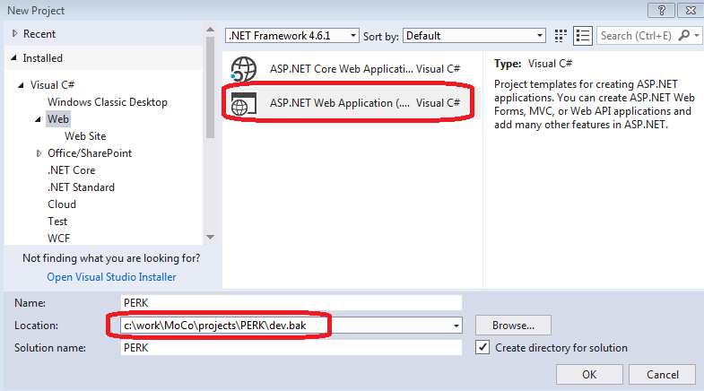
Initializing the project

Slide 6
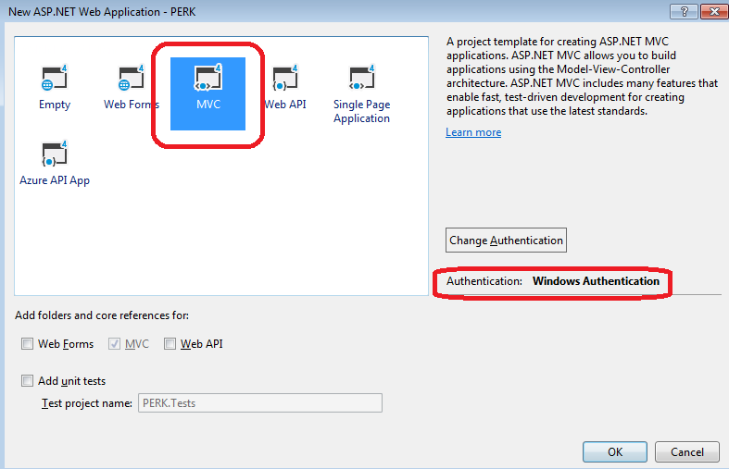
Use Windows Authentication

Slide 7
What is a Model?
A simple public C# class
Corresponds to a database table
Public properties correspond to columns in the table
Must have a reference in the database context
“Code First”
Write the model first
EF will manage changes to the database

Slide 8
Three initial models
Case
EvidenceReview
EvidenceItem
A Case has a collection of EvidenceReviews.
Each EvidenceReview has a collection of EvidenceItems.

Slide 9
Relationship between Models
When EF sees a public virtual property in one model that refers to another model …
… it creates a foreign key between the two tables.

Slide 10
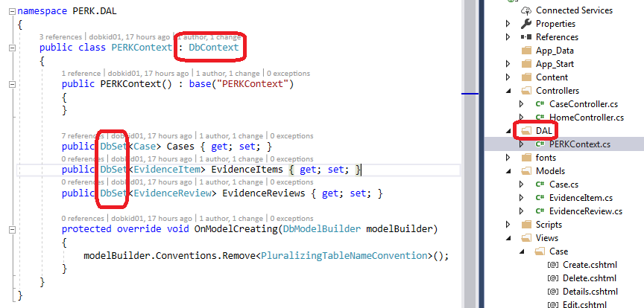
Creating the Database Context
Add a DAL folder to hold all contexts
Derive from DbContext
Add a public DbSet for each model

Slide 11
Configure the Context with a DB Connection

Slide 12
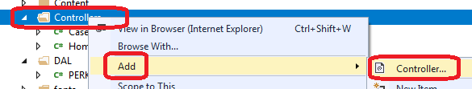
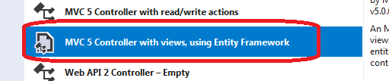
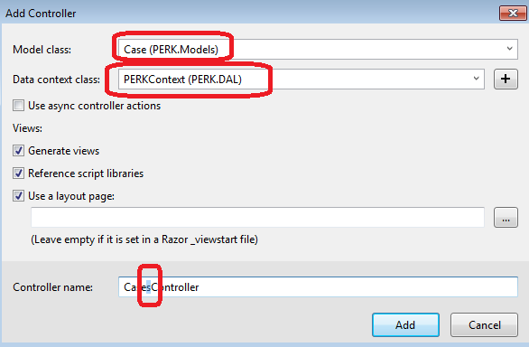
Generating a Controller

Slide 13
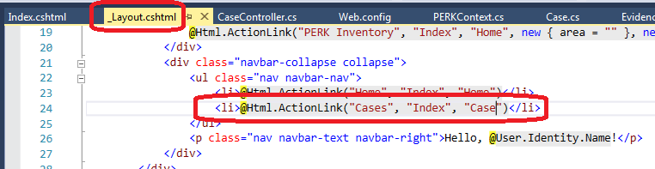
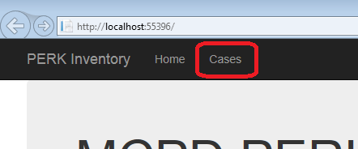
First Web Site Launch
Add an Action link to the case index:
F5 to launch the site:
Clicking the Cases link for the first time …

Slide 14

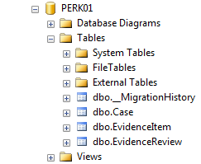
Database creation
… creates the database!

Slide 15
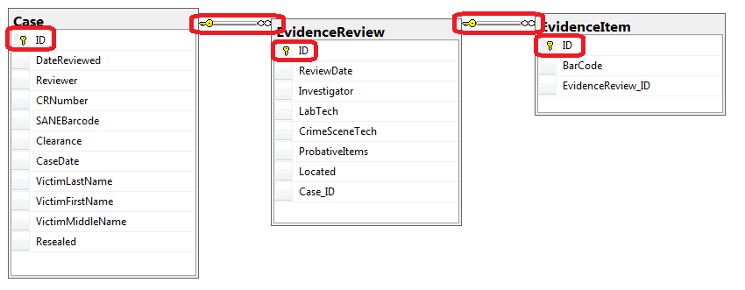
Table keys and relationships
EF automatically uses the “ID” property as the primary key
EF generates foreign key relationships for each collection property

Slide 16
Lesson 2- Migrations
commit f2e7b9a36bbdee9917a688b5f1c0784907a3f9ed
Author: dobkid01 <dobkid01@montgomerycounty.gov>
Date: Thu Jan 18 15:40:20 2018 -0500
Adding a table for some codes, and then adding the codes.

Slide 17
What is a migration?
A class module in the Migrations folder derived from DbMigration
Describes database changes made at a specific point in the development process, with a timestamp in the module name
Has an Up() method that implements the changes
Has a Down() method that undoes the changes
Migrations create a sequence that reconciles database version vs. code version

Slide 18
Migrations: Must vs. May
To start using migrations in a project:
Enable-Migrations
Once migrations are enabled on the project…
You must create one if you changed any models in the database context
EF automatically completes the Up() and Down()
You may create one for a database modification unrelated to the model
You manually write the Up() and Down() methods

Slide 19

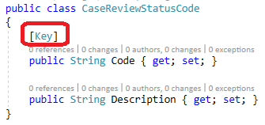
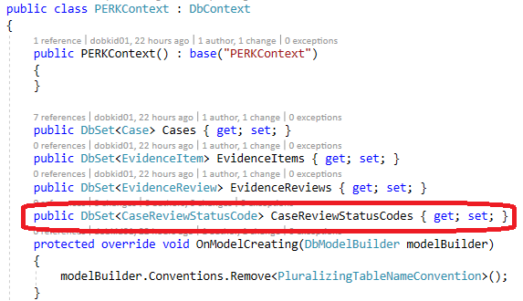
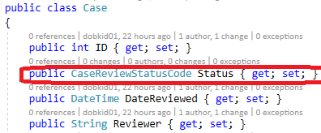
Status code class
Since key field is not ID nor CaseReviewStatusCodeID, must tell EF explicitly that Code is the primary key with the Key attribute
Add a DbSet in the DbContext
Add a CaseReviewStatusCode field to the Case class

Slide 20
Creating Status code migration
Now that the model has changed ➔
The database must be updated before the site can run
A migration must now be added before the database can be updated
Execute “Add-Migration CaseReviewStatusCode” ➔
EF writes an Up() that…
… creates the CaseReviewStatusCode table with Case as the primary key column
… creates the Status_Code column in the Case table
… creates an index on Case.Status_Code
… creates a foreign key from Case.Status_Code to CaseReviewStatusCode.Code

Slide 21
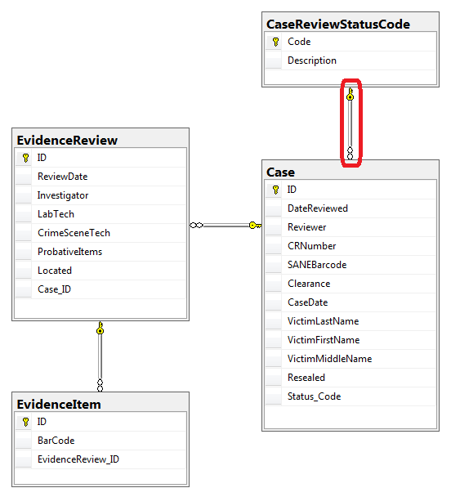
Creating the status code table
Update-Database
Creates empty table
Case/Code one-to-many relationship automatically implemented!

Slide 22
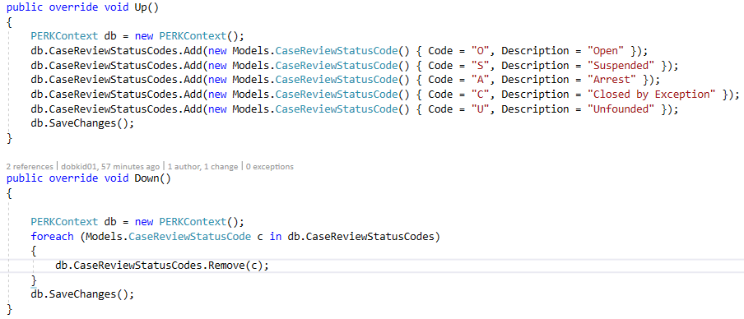
Populating the status code table, part 1
To add static data, you may create another migration:
Add-Migration FiveStatusCodes
Creates a new migration with empty Up() and Down() methods
You complete the Up() and Down()

Slide 23
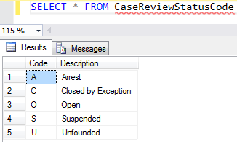
Populating the status code table, part 2
Run “Update-Database”
➔ table now has data

Slide 24
Migrations: time machine for DB design
To apply all migrations to the connected database:
Update-Database
To list all migrations applied thus far:
Get-Migrations
To revert database design to an earlier version:
Update-Database –TargetMigration:<migration-name>

Slide 25
Undoing and re-doing status code table
Update-Database -TargetMigration:201801182130012_CaseReviewStatusCode
Removes the data but leaves the table
Update-Database -TargetMigration:201801181648270_InitialCreate
Drops the table
Update-Database
Creates the table with its data again.

Slide 26
migrations applied on first use
If database doesn’t already exist:
It is automatically created the first time a user clicks a link that access the database,
…and all migrations are executed so that the database version matches the code version

Slide 27

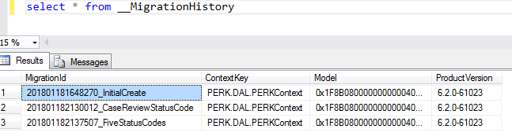
Code version vs database version
Compare Migrations folder vs. the __MigrationHistory table:

